Slide 1




SUPER MINI MART EXCEL PROJECT
BY SARTHAK TYAGI

Slide 2
Objective
Super Mini mart wants some insights into their 2022 sales data. So that, they can understand their customers and grow more sales in the upcoming year.
Requested Insights:-
Order vs Sales according to months.
Men vs Women Sales.
Number of orders through different channels.
Total sales by state.
Order status.
Order by age and gender

Slide 3
Slide 3
1
Firstly, I analyze the order and sales by month.
This Chart clearly indicates that total sales and total orders are highest in the month of March.

Slide 4
Slide 3
2
In this section, I analyzed the sales between men and women.
This pie chart clearly indicates that women purchase more than men.

Slide 5
Slide 3
3
In this section, the pie chart shows total number of orders by channels.
We can conclude from this pie chart that total number of orders on amazon is highest.

Slide 6
Slide 3
4
In this section, I tried to find the top 5 states with maximum sales.
We can further conclude that Maharashtra, Karnataka, and Uttar Pradesh are the top 3 states in terms of maximum sales.

Slide 7
Slide 3
5
This pie chart shows the percentage between different order statuses.
The percentage of delivered items is good but further company should try to improve it.

Slide 8
Slide 3
6
This section analyzes the total orders in terms of various age groups and genders.
We can clearly conclude that adult women order more than anyone else.

Slide 9
Conclusion
Super Mini Store should promote its marketing strategies using coupons/discounts/offers on social media to adult women in the state of Maharashtra, Karnataka and Uttar Pradesh through the channel Amazon, Flipkart and Myntra.

Slide 10
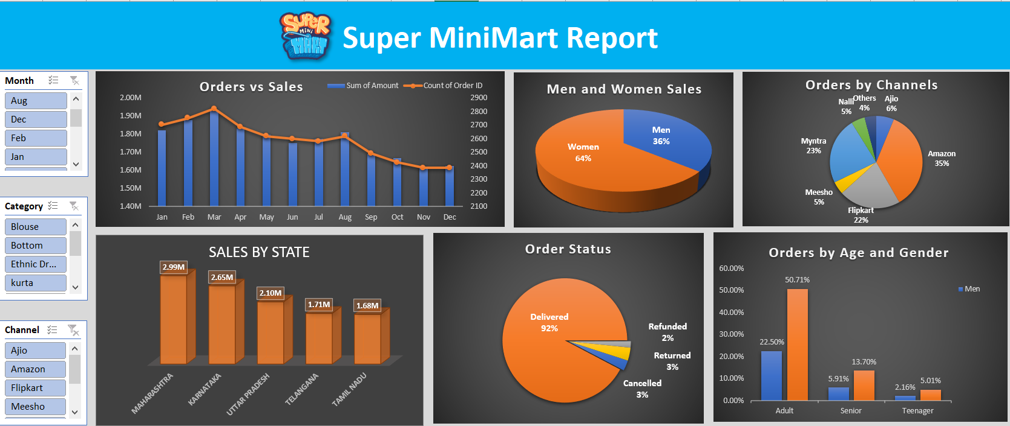
Research Presentation End
BY SARTHAK TYAGI
Notes:
You can use this slide as your opening or closing slide. Should you choose to use it as a closing, make sure you review the main points of your presentation. One creative way to do that is by adding animations to the various graphics on a slide. This slide has 4 different graphics, and, when you view the slideshow, you will see that you can click to reveal the next graphic. Similarly, as you review the main topics in your presentation, you may want each point to show up when you are addressing that topic.
Add animation to images and graphics:
Select your image or graphic.
Click on the Animations tab.
Choose from the options. The animation for this slide is “Split”. The drop-down menu in the Animation section gives even more animations you can use.
If you have multiple graphics or images, you will see a number appear next to it that notes the order of the animations.
Note: You will want to choose the animations carefully. You do not want to make your audience dizzy from your presentation.

